Slide 1



GIT ASSIGNMENT
Presented By : Deeksha Tripathi

Slide 2
AGENDA
Introduction to GIT
About GitHub
Git Commands
Creating Empty Repository
Basic Git workflow
Branches
Common Options in branch
GitHub link
Conclusion

Slide 3
WHAT IS GIT ?
Git is a free, open source distributed version control system (VCS). It is useful in keeping the tracks of projects and files as they change over time with the help of different contributors. Git helps keep track of changes made to a code. It also helps us to see what changes have been made to the code over time.
Version Control System is a system that records changes to a file, or set of files, over time so that we can recall specific versions later.

Slide 4

What is GitHub?
What is GitHub?
GitHub is a code hosting platform for collaboration and version control.
GitHub helps us and others to work together on projects.
GitHub essentials are:
Repositories
Branches
Commits
Pull Requests
Git (the version control software GitHub is built on)

Slide 5
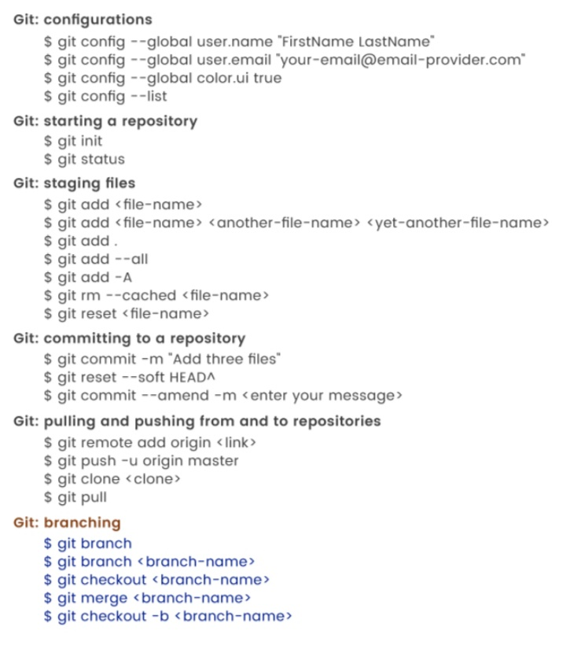
GIT COMMANDS

Slide 6
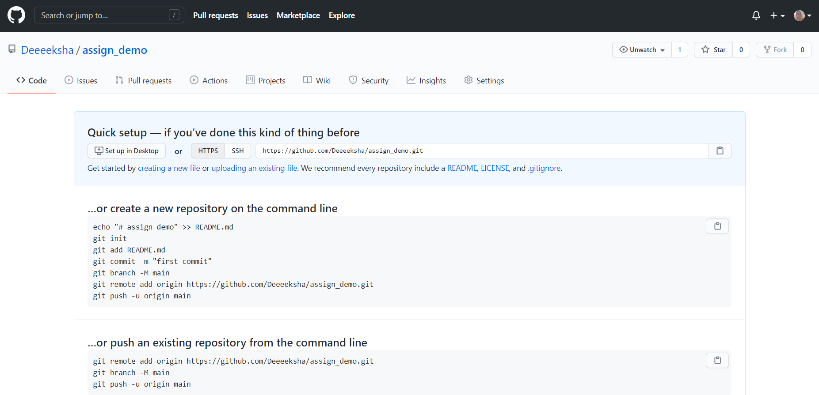
CREATING AN EMPTY REPOSITORY ON GITHUB

Slide 7
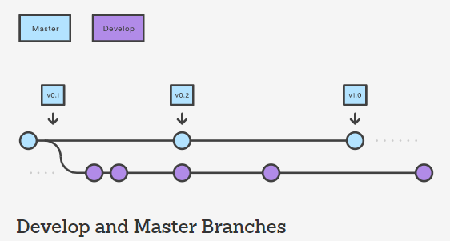

BASIC GIT WORKFLOW
A Git workflow is a recipe or recommendation for how to use Git to accomplish work in a consistent and productive manner. Git workflows encourage developers and DevOps teams to leverage Git effectively and consistently. The Centralized Workflow is a great Git workflow for teams transitioning from SVN. Like Subversion, the Centralized Workflow uses a central repository to serve as the single point-of-entry for all changes to the project. Instead of trunk, the default development branch is called main and all changes are committed into this branch. This workflow doesn’t require any other branches besides main.
Developers start by cloning the central repository. In their own local copies of the project, they edit files and commit changes as they would with SVN; however, these new commits are stored locally - they’re completely isolated from the central repository. This lets developers defer synchronizing upstream until they’re at a convenient break point. To publish changes to the official project, developers "push" their local main branch to the central repository. This is the equivalent of svn commit, except that it adds all of the local commits that aren’t already in the central main branch.

Slide 8
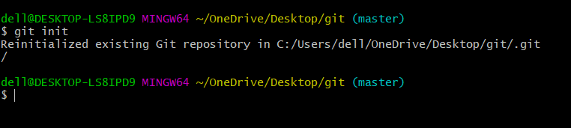

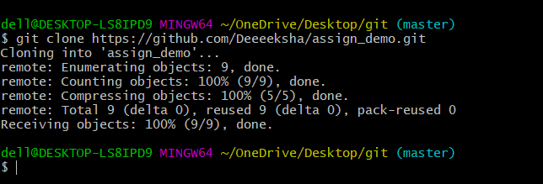

Initializing the central repository:
Clone the central repository:

Slide 9
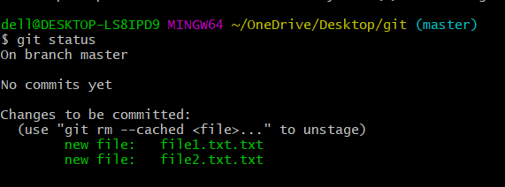
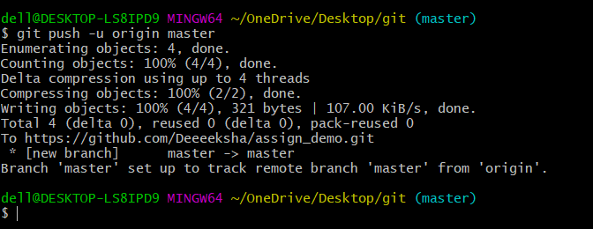
Checking Status of the Repo:
Pushing New Commit:

Slide 10

GIT SGITgggggggggggggggggggggggggggg BRANCHES

Slide 11

GIT BRANCHES
This document is an in-depth review of the git branch command and a discussion of the overall Git branching model. Branching is a feature available in most modern version control systems. Branching in other VCS's can be an expensive operation in both time and disk space. In Git, branches are a part of your everyday development process. Git branches are effectively a pointer to a snapshot of your changes. When you want to add a new feature or fix a bug no matter how big or how small you spawn a new branch to encapsulate your changes. This makes it harder for unstable code to get merged into the main code base, and it gives you the chance to clean up your future's history before merging it into the main branch.
r

Slide 12

Common Options used in Branch
Git Branch
Creating new Branch
Switching Branch
Merging Branch
Deleting Branch
GIT BRANCH : It lists all the branches in your repository

Slide 13
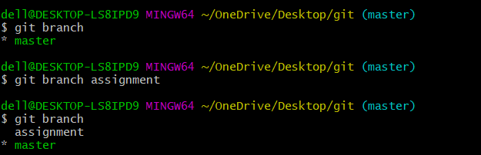
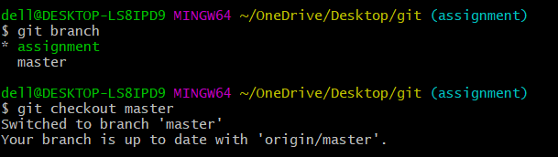
Creating a New Branch : It will Create a new branch called ＜branch＞. This does not check out the new branch.
Switching Branch : It will switch from one branch to another branch.

Slide 14
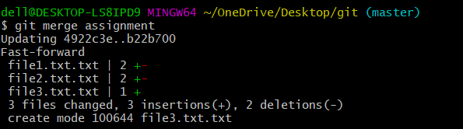
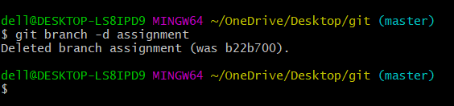
Merging Branches together : It will merge branches together .
Deleting a Branch: This is helpful in deleting the branch which you don’t want to use.

Slide 15
MY GITHUB LINK -
https://github.com/Deeeeksha/assign_demo.git

Slide 16
Thank You!

